Slide 1
RDBES – Lower hierarchy
Presented by Kirsten Birch Håkansson, DTU Aqua
WKRDBES-INTRO3, September 2024
Data model 1.19.20 and codes per 20240924

Slide 2
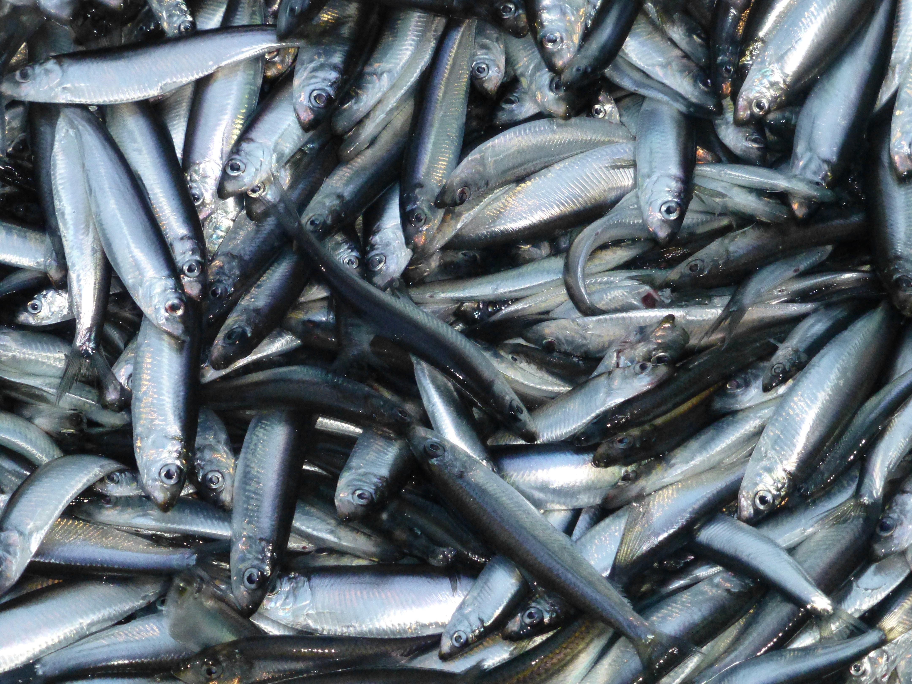
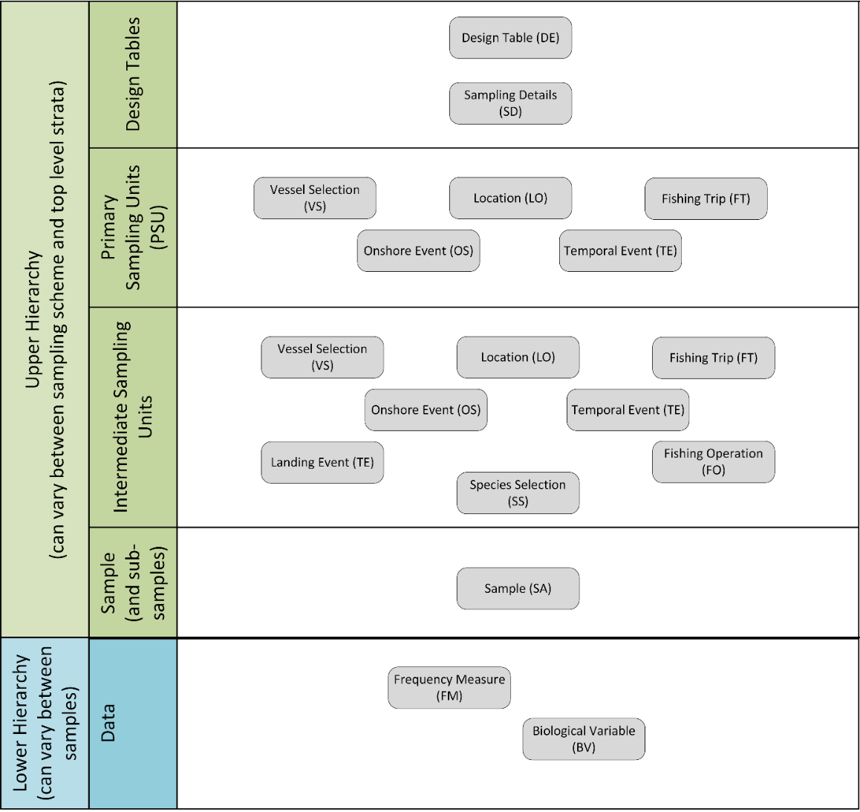
Lower hierarchy

Slide 3
Lower hierarchy
No updates, since last data model.
Only two tables;
Frequency Measure (FM)
Biological Variable (BV)
(Specification in Sample (SA))
Introduce the tables
Introduce the hierarchies
Some FAQ’s

Slide 4
Frequency Measure (FM)
Quite like the present RDB CS.HL and DATRAS HL table, but much more informative and with the possibility to hold a weight frequency (used for large pelagic)
Frequencies (length, width or weight) of none individual fish
No fields for selection (no design variables). Selection takes place in the sample table
Record type | Sequence number | Parent Sequence Number | Stratification | Sample stratum | Species code | Species code FAO |  |  |  |  |  |  | Total Weight Measured | Sample weight Measured | Sampling Unit Total | Sampling Unit Sampled
SArecordType | SAsequenceNumber | SAparentSequenceNumber | SAstratification | SAstratumName | SAspeciesCode | SAspeciesCodeFAO |  |  |  |  |  |  | SAtotalWeightMeasured | SAsampleWeightMeasured | SAnumberTotal | SAnumberSampled
M | O | DV, M | DV, M | M | O | O |  |  |  |  |  |  | O | O | DV, O | DV, O
SA | 1 |  | Yes | S1 | 126436 | COD |  |  |  |  |  |  | 95 | 50 | 2 | 1
SA | 2 |  | No | S2 | 126436 | COD |  |  |  |  |  |  | 202 | 50 | 4 | 1
Record type | Length or weight class measured | Number at unit (not raised to whole catch) | Measurement type (measured) | Accuracy code
FMrecordType | FMclassMeas | FMnumberAtUnit | FMtypeMEas | FMaccuracy
M | M | M | M | O
FM | 100 | 1 | LengthTotal | cm
FM | 110 | 2 | LengthTotal | cm
FM | 120 | 2 | LengthTotal | cm
FM | 130 | 3 | LengthTotal | cm
FM | 140 | 4 | LengthTotal | cm
FM | 150 | 5 | LengthTotal | cm
FM | 160 | 2 | LengthTotal | cm
FM | 170 | 1 | LengthTotal | cm
FM | 180 | 1 | LengthTotal | cm

Slide 5
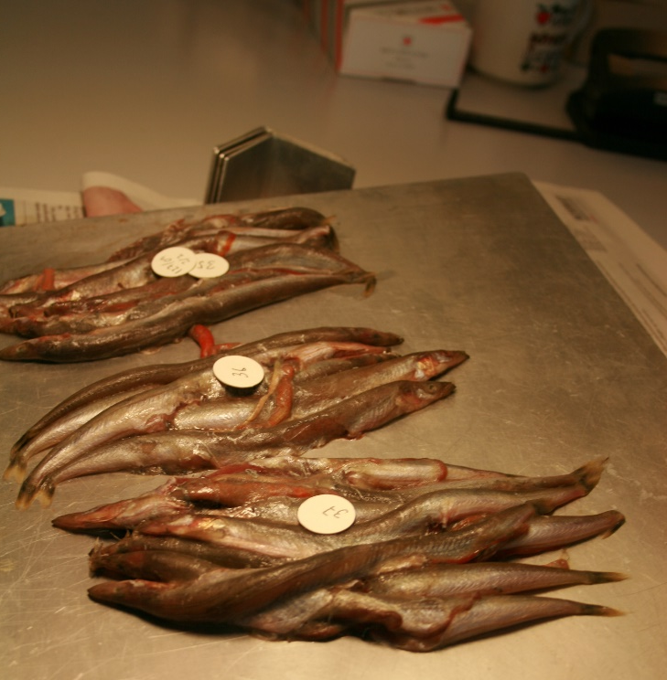
Frequency Measure (FM) - Additional grouped measurement
FMrecordType | FMclassMeas | FMnumberAtUnit | FMtypeMeas | FMmeasurementEquipment | FMaccuracy | Fmsampler | FMaddGrpMeasurement | FMaddGrpMeasurementType
FM | 185 | 10 | TotalLength |  | scm | Observer | 210 | g
10 Ammodytes – all measuring 185 mm – and with a grouped weight of 210 g
Additional grouped measurement + Additional grouped measurement type
For now, only ‘total measured weight (g)’ is allowed as additional grouped measurement. The weight correspond to the presentation and state field in the FM table.

Slide 6
Frequency Measure (FM), newer fields - Same fields in Biological Variable (BV)
State of processing (FMstateOfProc) and Presentation (FMpres)
These can differ from the sample in the SA, a sub-sample is taken from fresh fish (SAstateOfProc = FRE) and the Total weight measured (SAtotalWtMes) and Sample weight measured (SAsampWtMes) is related to that state of processing. The sub-sample is then frozen for further analysis. Later the subsample is thawned and a FM is taken (FMstateOfProc = FRO)

Slide 7
Frequency Measure (FM), newer fields - Same fields in Biological Variable (BV)
Type of measurement done (FMtypeMeas) and type of measurement assessment (FMtypeAssess) and the conversion factor assessment between these two (FMconFacAssess)
If the measurement type is not needed for an assessment, the measurement type from the ‘FMtypeMeas' should be repeated in the field and the conversion factor ‘FMconFacAssess’ set to 1.
For length and weight for assessed species/stocks the FMtypeAssess could potentially be different from the FMtypeMeas. If so, ‘FMconFacAssess’ should be populated with the correct value.
Record type | Length or weight class measured | Number at unit (not raised to whole catch) | Measurement type (measured) | Accuracy code | Conversion factor assessment | Measurement type for assessment
FMrecordType | FMclassMeas | FMnumberAtUnit | FMtypeMeas | FMaccuracy | FMconFacAssess | FMtypeAssess
M | M | M | M | O | M | M
FM | 100 | 1 | LengthTail | mm | 0.9 | LengthCarapace
FM | 110 | 2 | LengthTail | mm | 0.9 | LengthCarapace
FM | 120 | 2 | LengthTail | mm | 0.9 | LengthCarapace
FM | 130 | 3 | LengthTail | mm | 0.9 | LengthCarapace
FM | 140 | 4 | LengthTail | mm | 0.9 | LengthCarapace
FM | 150 | 5 | LengthTail | mm | 0.9 | LengthCarapace
FM | 160 | 2 | LengthTail | mm | 0.9 | LengthCarapace
FM | 170 | 1 | LengthTail | mm | 0.9 | LengthCarapace
FM | 180 | 1 | LengthTail | mm | 0.9 | LengthCarapace

Slide 8
Biological Variable (BV)
Very similar to the present RDB CS.CA and DATRAS CA, but more informative and with added field for selection (the usual design variables (minus clustering))
The table has been transposed, so each line holds a single measurement, which allows for different protocols for selecting individual fish for different measurements e.g., 2 individuals per length are selected for aging and 4 individuals per length are selected for weighting. Further, it also makes it much easier to add new measurement types in the future.
One row holds a single individual. The same fish can be there more than one row.
BVrecord-Type | BVfishId | BVstateOfProc | BVpres | BVstratifi-cation | BVstratum-Name | BVtypeMeas | BVvalue | BVvalue-Type | BVnumberTotal | BVnumber-Sampled | BVselection-Prob | BVinclusion-Prob | BVselection-Method | BVunitName | BVsampler
M | M | M | M | DV, M | DV,M | M | M | M | DV,O | DV,O | DV,O | DV,O | DV,M | DV,M | O
BV | 7681346 | FRE | WHL | N | U | Age | 1 | Year | 100 | 4 |  |  | SRSWR | fish7681346 | Observer
BV | 7681347 | FRE | WHL | N | U | Age | 2 | Year | 100 | 4 |  |  | SRSWR | fish7681347 | Observer
BV | 7681348 | FRE | WHL | N | U | Age | 1 | Year | 100 | 4 |  |  | SRSWR | fish7681348 | Observer
BV | 7681349 | FRE | WHL | N | U | Age | 2 | Year | 100 | 4 |  |  | SRSWR | fish7681349 | Observer
BV | 7681346 | FRE | WHL | N | U | WeightLive | 33 | g | 100 | 4 |  |  | SRSWR | fish7681346 | Observer
BV | 7681347 | FRE | WHL | N | U | WeightLive | 34 | g | 100 | 4 |  |  | SRSWR | fish7681347 | Observer
BV | 7681348 | FRE | WHL | N | U | WeightLive | 34 | g | 100 | 4 |  |  | SRSWR | fish7681348 | Observer
BV | 7681349 | FRE | WHL | N | U | WeightLive | 35 | g | 100 | 4 |  |  | SRSWR | fish7681349 | Observer

Slide 9
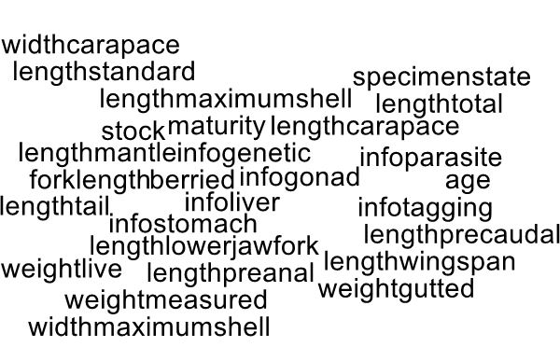
Biological Variable (BV), type measured
BVtypeMeasured | BiologicalMeasurementType //vocab.ices.dk/?ref=1606
BVvalueMeasured | Code lists behind the scene
BVvalueUnitOrScale | ValueUnitOrScale //vocab.ices.dk/?ref=1625
BVmethod | SampleType //vocab.ices.dk/?ref=1507
BVmeasurementEquipment | METOA //vocab.ices.dk/?ref=173
BVaccuracy | AccuracyCode //vocab.ices.dk/?ref=1608
BVcertaintyQualitative | MeasurementCertainty //vocab.ices.dk/?ref=1682
BVcertaintyQuantitative
BVconversionFactorAssessment
BVtypeAssessment | BiologicalMeasurementType //vocab.ices.dk/?ref=1606
 | GeneticPopulation OtolithCollected IlliciumCollected ScaleCollected VertebraCount HatchSeason LengthPinchedTail

Slide 10
The lower hierarchies
There are four lower hierarchies (A, B, C, D), these are declared in the Sample table
Record type | Sequence number |  |  | Sample stratum |  | Species code FAO |  |  |  |  |  |  | Total Weight Measured | Sample weight Measured | Sampling Unit Total | Sampling Units Sampled | Lower Hierarchy
SArecordType | SAsequenceNumber |  |  | SAstratumName |  | SAspeciesCodeFAO |  |  |  |  |  |  | SAtotalWeightMeasured | SAsampleWeightMeasured | SAnumberTotal | SAnumberSampled | SAlowerHierarchy
M | O |  |  | M |  | O |  |  |  |  |  |  | O | O | DV, O | DV, O | M/O
SA | 1 |  |  | S1 |  | COD |  |  |  |  |  |  | 95 | 50 | 2 | 1 | A
SA | 2 |  |  | S2 |  | COD |  |  |  |  |  |  | 202 | 50 | 4 | 1 | B

Slide 11
Lower hierarchy A - Stratification of BV’s based on FM
The sample of a specific species is length measured and stratified by length into 1 cm classes. A fixed number of specimens is biologically sampled from each class (e.g., 2 individuals from each length class). Length, weight, sex and age are determined for each of them.
Variants:
Different length classes (e.g., 1mm, 0.5cm, 2.5cm, etc.)
Different sample sizes from each length class (e.g., proportional to the number of fish in the length class).
Additional biological variables on each fish sampled (e.g., maturity, stock, age quality, etc.)
Upper Hierarchy Link: Sample (SA)
1:n
Frequency Measure (FM)
1:n
Biological Variable (BV)
Legend
Mandatory table in hierarchy

Slide 12
Lower hierarchy A – example
FMid | FMrecordType | FMclass | FMnumberAtUnit | FMtypeMeas | FMMeasurementEquipment | FMaccuracy | FMsampler
 | M | M | M | M | O | O | O
1 | FM | 350 | 1 | LengthTotal |  | cm | Observer
2 | FM | 360 | 3 | LengthTotal |  | cm | Observer
3 | FM | 370 | 3 | LengthTotal |  | cm | Observer
4 | FM | 380 | 5 | LengthTotal |  | cm | Observer
5 | FM | 390 | 2 | LengthTotal |  | cm | Observer
6 | FM | 400 | 3 | LengthTotal |  | cm | Observer
7 | FM | 410 | 2 | LengthTotal |  | cm | Observer
8 | FM | 420 | 5 | LengthTotal |  | cm | Observer
9 | FM | 430 | 1 | LengthTotal |  | cm | Observer
10 | FM | 440 | 1 | LengthTotal |  | cm | Observer
11 | FM | 450 | 2 | LengthTotal |  | cm | Observer
12 | FM | 460 | 1 | LengthTotal |  | cm | Observer
13 | FM | 470 | 1 | LengthTotal |  | cm | Observer
14 | FM | 480 | 1 | LengthTotal |  | cm | Observer
FMid | BVrecordType | BVfishId | BVstratification | BVstratumName | BVtypeMeas | BVvalue |  |  |  | BVnumberTotal | BVnumberSampled
 | M | M | DV, M | DV,M | M | M |  |  |  | DV,O | DV,O
1 | BV | 7681346 | No | U | Age | 1 |  |  |  | 1 | 1
2 | BV | 7681347 | No | U | Age | 2 |  |  |  | 3 | 1
3 | BV | 7681348 | No | U | Age | 1 |  |  |  | 3 | 1
4 | BV | 7681349 | No | U | Age | 2 |  |  |  | 5 | 1
5 | BV | 7681350 | No | U | Age | 2 |  |  |  | 2 | 1
6 | BV | 7681351 | No | U | Age | 2 |  |  |  | 3 | 1
7 | BV | 7681352 | No | U | Age | 2 |  |  |  | 2 | 1
8 | BV | 7681353 | No | U | Age | 2 |  |  |  | 5 | 1
9 | BV | 7681354 | No | U | Age | 2 |  |  |  | 1 | 1
10 | BV | 7681355 | No | U | Age | 3 |  |  |  | 1 | 1
11 | BV | 7681356 | No | U | Age | 3 |  |  |  | 2 | 1
12 | BV | 7681357 | No | U | Age | 3 |  |  |  | 1 | 1
13 | BV | 7681358 | No | U | Age | 3 |  |  |  | 1 | 1
14 | BV | 7681359 | No | U | Age | 3 |  |  |  | 1 | 1

Slide 13
Lower hierarchy B - Only a frequency exist
The sample of a specific species is length measured to the lowest cm. No further biological analyses are carried out on the specimens.
Variants:
Different length classes (e.g., 1mm, 0.5cm, 2.5cm, etc.)
Upper Hierarchy Link: Sample (SA)
1:n
Frequency Measure (FM)
Legend
Mandatory table in hierarchy

Slide 14
Lower hierarchy C - Everything is on individual specimens
The subsample of a specific species is entirely biologically analysed.
Variants:
Various biological variables collected on each fish sampled (e.g., length, maturity, stock, age quality, etc.)
Length is not among the variables sampled (e.g., sampling directly for ages)
Upper Hierarchy Link: Sample (SA)
1:n
Biological Variable (BV)
Legend
Mandatory table in hierarchy

Slide 15
Lower hierarchy D - No biological measurements
No length measurements or biological analyses, so nothing below the SA record
Example: Danish observers at-sea will often only sample the weight of the landings
SArecordType |  |  |  | SAstratumName |  | SAspeciesCodeFAO |  |  |  |  |  |  | SAtotalWeightMeasured | SAsampleWeightMeasured | SAnumberTotal | SAnumberSampled | SAlowerHierarchy
M |  |  |  | M |  | O |  |  |  |  |  |  | O | O | DV, O | DV, O | M/O
SA |  |  |  | LAN |  | COD |  |  |  |  |  |  | 95 | 100 |  |  | D
SA |  |  |  | DIS |  | COD |  |  |  |  |  |  | 202 | 50 |  |  | A

Slide 16
Sampling for a frequency and then subsampling for biological measurements, no length stratification - example
In Denmark we often sample small pelagic the following way; We have a sample of herring from a fishing trip (here 1150 kg), then we take a subsample (here 29.957 kg, equal to 100 fish). All these fish are length measured. Only 25 of the fish are aged. the subsampling is not length stratified but an unstratified subsample. We sample the fish in a pseudo-systematic way, so the fish are ordered by length and then each 4th fish is selected in this case
This won’t fit into hierarchy A, since there is no length stratification involved in the subsampling
How to fit: Utilizing the possibility to add a subsample in the sample table. The first sample (for the representative length measurements) will have SAlowerHierarchy= B. The subsample thereof (for biological measurements) will link to the sample via SAparentSequenceNumber and have SAlowerHierarchy = C
SArecordType | SAsequenceNumber | SAparentSequenceNumber | SAstratification | SAstratumName |  | SAspeciesCodeFAO |  |  |  | SAunitType | SAtotalWeightLive | SAsampleWeightLive | SAtotal | SAsampled |  | SAselectionMethod | SAlowerHierarchy
M | O | DV, M | DV, M | M |  | O |  |  |  | M | O | O | DV, O | DV, O |  | DV, M | M/O
SA | 1 |  | No | U |  | HER |  |  |  | kg | 1150000 | 29957 |  |  |  | NPQSRSWOR | B
SA | 2 | 1 | No | U |  | HER |  |  |  | fish | 29957 | 6146 | 100 | 25 |  | NPQSYSS | C

Slide 17
Two selection method particularly developed for sub-sampling of BV’s
Clearly marking ‘none-representative’ fish
Cross-Level Quota Sampling at the Trip level (NPCLQS-T): The selection is restricted by a quota at the trip level and not at the level where the unit is selected. E.g., collecting otoliths for a ALK at the trip level.
Cross-Level Quota Sampling at levels Other than a trip (NPCLQS-O): The selection is restricted by a quota at a level other than a trip. E.g. at the level of species, area and quarter
(if more common case of exist the these can be added as a code e.g. for species, area, quarter, then maybe NPCLQS-SAQ)
See FAQ 20 in RDBES Documentation of the Data Model
E.g., FAQ 20 - Question: When in an onboard trip the length frequencies may be collected at haul level but the sampling goals in terms of number of ages that observers aim to collect per length-class is set at trip level. How should this information be entered in the RDBES?

Slide 18
Help needed
See the documentation and FAQs and examples included
RDBES Documentation of the Data Model
Look for similar issues at https://github.com/ices-tools-dev/RDBES/issues
If no help raise an issue at https://github.com/ices-tools-dev/RDBES/issues
Any questions?

